Slide 1


Christos Koronios
August 14, 2022

Slide 2
Outline
Executive Summary
Introduction
Methodology
Results
Conclusion
Appendix

Slide 3
Summary of methodologies
Data Collection via API & Web Scraping
Data Wrangling
Exploratory Data Analysis with SQL
Exploratory Data Analysis with Data Visualization
Interactive Visual Analytics with Folium
Interactive dashboard (Plotly Dash)
Machine Learning Predictive analysis (Classification)
Summary of all results
Exploratory Data Analysis outcome
Interactive analysis
Predictive analysis
Executive Summary

Slide 4
Introduction
Project background and context
Space X advertises Falcon 9 rocket launches on its website with a cost of 62 million dollars; other providers cost upward of 165 million dollars each, much of the savings is because Space X can reuse the first stage. Therefore, if we can determine if the first stage will land, we can determine the cost of a launch. This information can be used if an alternate company wants to bid against space X for a rocket launch. This goal of the project is to create a machine learning pipeline to predict if the first stage will land successfully.
Problems you want to find answers
Which factors determine the success of the first stage's rocket launch?
The interconnection among the various parameters of the rocket launch
What operating conditions needs to be in place to ensure a successful landing program.

Slide 5

Section 1

Slide 6
Executive Summary
Data collection methodology:
SpaceX Rest API
Web Scraping from Wikipedia
Perform data wrangling
One-hot encoding
Perform exploratory data analysis (EDA) using visualization and SQL
Perform interactive visual analytics using Folium and Plotly Dash
Perform predictive analysis using classification models
Classification models LR, KNN, SVM and DT were built and evaluated
Methodology

Slide 7
Data Collection
Data collection through get request to the SpaceX API.
Data collection through Web scraping and BeautifulSoup from Wikipedia
The response date was stored as a Json, normalized and restored as pandas' dataframe
Data wrangling technics such as replacing null values with their respective means

Slide 8

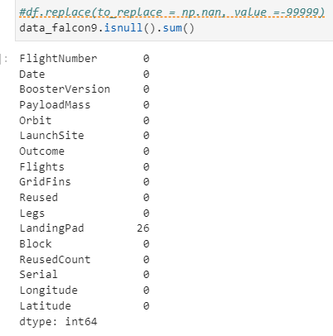
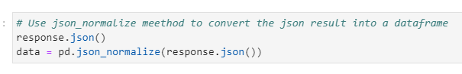
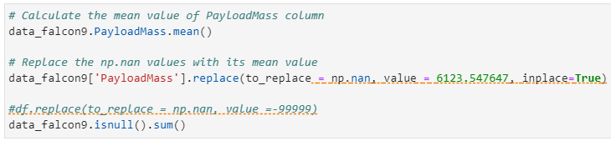
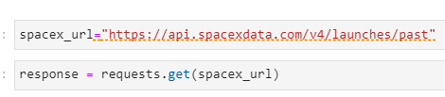
Data Collection – SpaceX API
Get
Normlize
Clean
Show
LINK

Slide 9
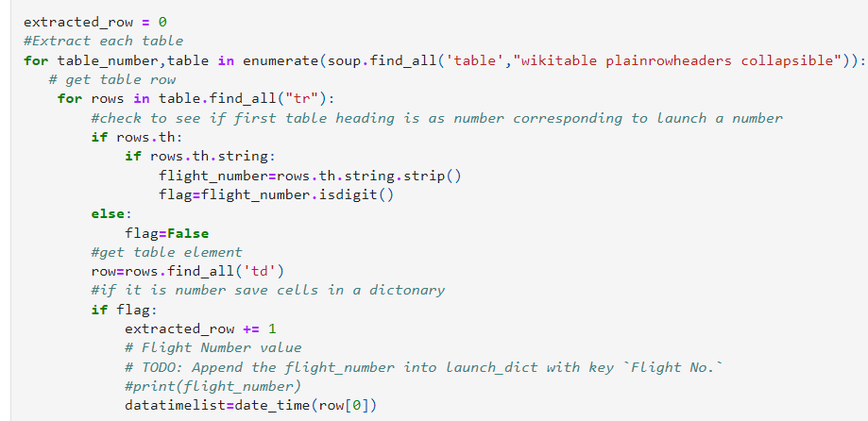
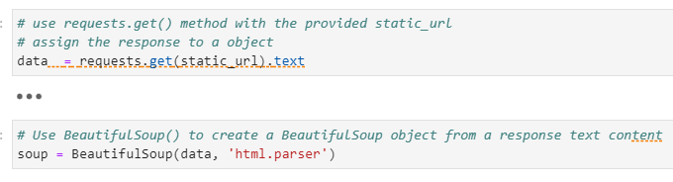
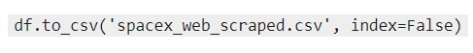

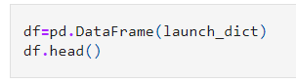
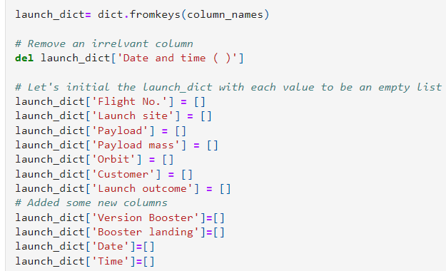
Data Collection - Scraping
Response from HTML
BeautifulSoup
Create Dictionary
Append
Convert to DF
DF to CSV
LINK

Slide 10
k
Data Wrangling Process
Identify null values
Identify how many lunches occurred from each launch site
Identify the occurrence of each orbit
Identify the occurrence of each orbit per orbit type
Create landing outcome label from outcome column and export to csv
LINK to the notebook
Data Wrangling

Slide 11
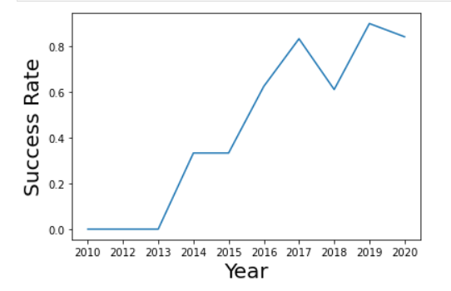
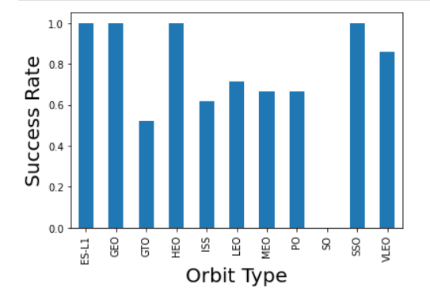
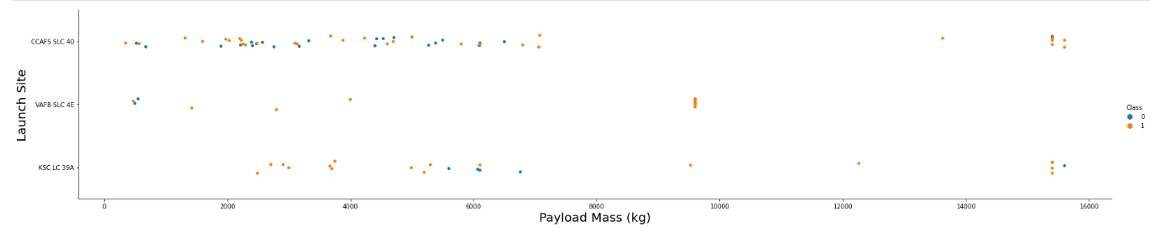
EDA with Data Visualization
LINK to workbook

Slide 12
EDA with SQL
We gained further insight in the dataset via SQL queries such as
The names of unique launch sites in the space mission.
The total payload mass carried by boosters launched by NASA (CRS)
The average payload mass carried by booster version F9 v1.1
The total number of successful and failure mission outcomes
The names of the boosters with success in ground pad given specific payload mass
The failed landing outcomes in drone ship, their booster version and launch site names
LINK to the notebook

Slide 13
Build an Interactive Map with Folium
The followed process can be summarized into five steps
Create objects on the map such as markers and circles to depict the launch sites
Quantity 'Success Rate' using binary system, 0 for failure and 1 for success
Mark them on the map
Identify the key locations in the proximities (I.e. Railway and Coastline)
Calculate their distance from them

Slide 14
Build a Dashboard with Plotly Dash
The Dashboard consists of
A dropdown Filtering option for the Lauch Sites
A Pie Chart for illustration
A Scatter Chart for illustration
A Rangeslider for the Payload mass a second Filtering mechanism
Link to the workbook

Slide 15
Predictive Analysis (Classification)
The followed process can be summarized into three main steps
Build the ML model
Create a new column
Standardize the data
Split the data
Build the model and fit the training data
Model Evaluation
Select the correct Evaluation method
Depict the Confusion matrices
Select the correct ML model
Select the model with the highest accuracy
LINK to the workbook

Slide 16
Results
Lower weight payloads are mostly connected to higher Success rates
Machine Learning Classification models SVM, KNN and LR showed a surprisingly identical Evaluation figure
KSC LC had the most successful launches
Between 2013 and 2017 the Success Rate of all sites showed an upward trend
The Launch Sites are particularly close to the coastline

Slide 17

Section 2

Slide 18
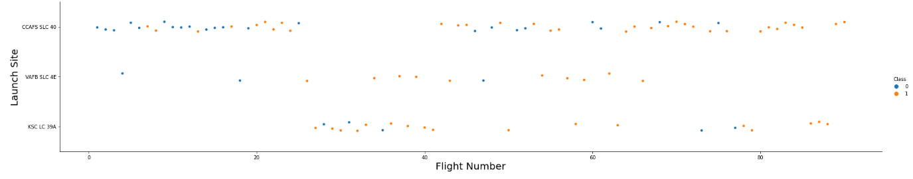
Flight Number vs. Launch Site
Launch Site CCASF SLC 40 has the most launches

Slide 19
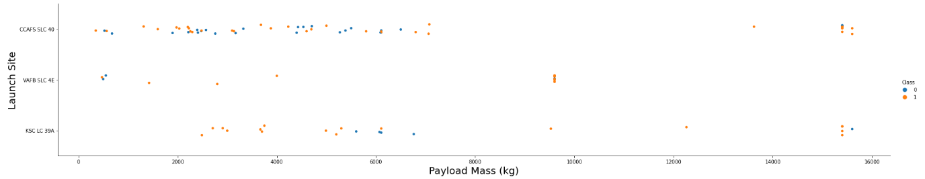
Payload vs. Launch Site
The scatterplot illustrates a Positive trend between the increase of the Payload Mass and the Success Rate (The higher the PM the higher the SR)

Slide 20
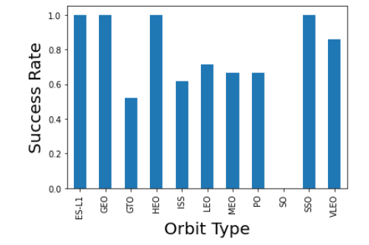
Success Rate vs. Orbit Type
The highest Success Rate occurs for the Orbit Types ES-L1, GEO, HEO and SSO

Slide 21
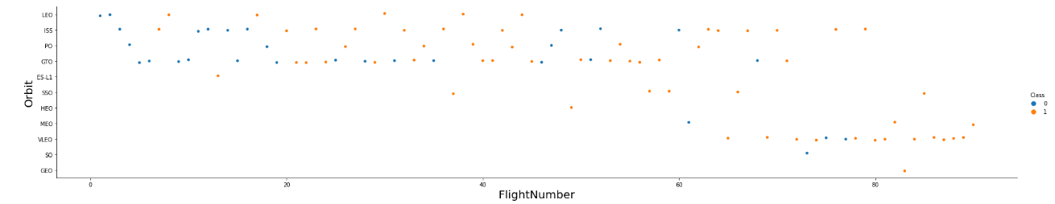
Flight Number vs. Orbit Type
The plow shows that there is a slightly positive relationship between the Flight Number and each Orbit Type although it is not a strong one

Slide 22
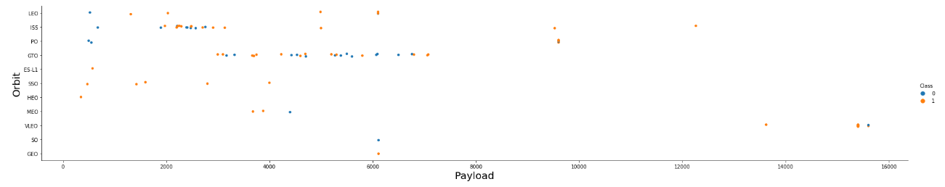
Payload vs. Orbit Type
Heavy Payloads mean higher Successful Rate for Polar, LEO and ISS

Slide 23
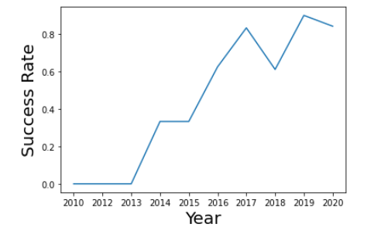
Launch Success Yearly Trend
There was a sharp upwards trend between 2013 and 2017

Slide 24
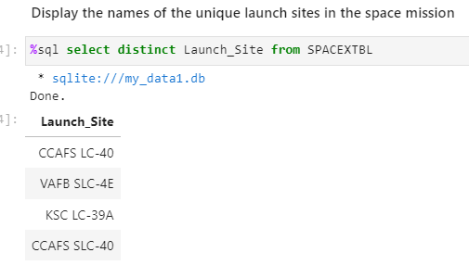
All Launch Site Names
We use the 'distinct' statement to fetch one distinct values of the Launch Sites

Slide 25
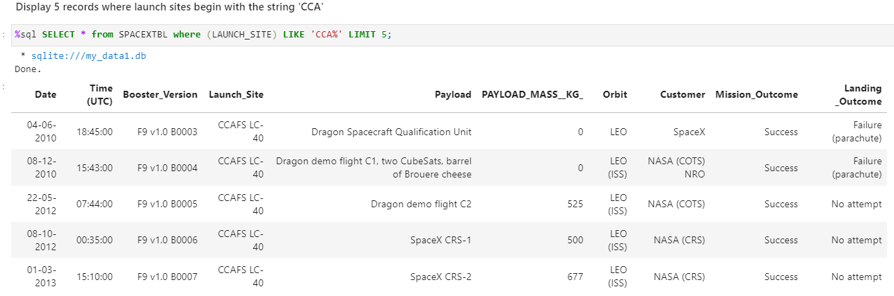
Launch Site Names Begin with 'CCA'
We use the 'Limit' statement to limit our search to five rows

Slide 26
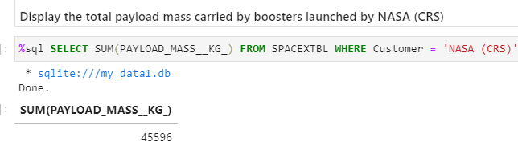
Total Payload Mass
We use the 'sum' function to get the sum of an attribute

Slide 27
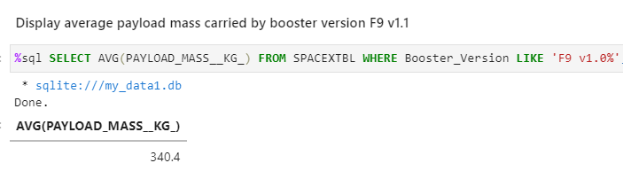
Average Payload Mass by F9 v1.1
We use the 'AVG' function to get the average payload

Slide 28
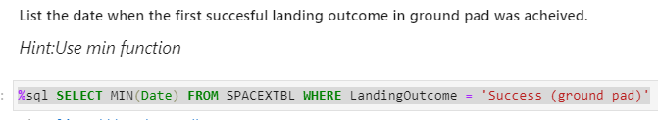
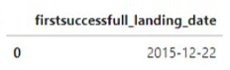
First Successful Ground Landing Date
We use the 'MIN' function to receive the first successful landing date
The code is %sql SELECT MIN(Date) FROM SPACEXTBL WHERE LandingOutcome = 'Success (ground pad)'
The outcome was December 22nd, 2015

Slide 29
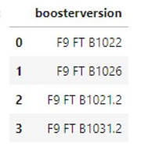
Successful Drone Ship Landing with Payload between 4000 and 6000
Code
%sql SELECT BOOSTER_VERSION FROM SPACEXTBL WHERE LANDING_OUTCOME = 'Success (drone ship)' AND 4000 < PAYLOAD_MASS__KG_ < 6000
Outcome

Slide 30
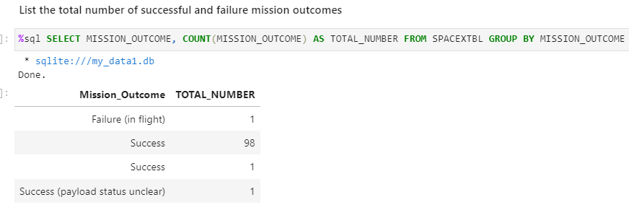
Total Number of Successful and Failure Mission Outcomes
We use the 'COUNT' function and we group the data with the 'GROUP BY' clause

Slide 31
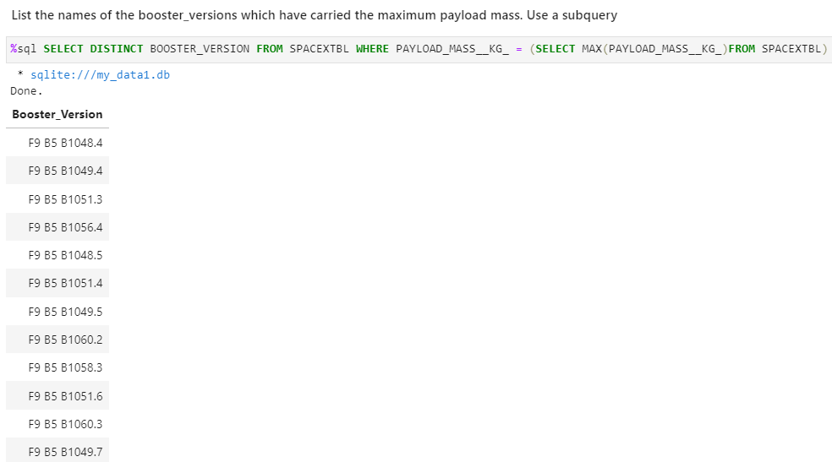
Boosters Carried Maximum Payload
We used the 'MAX' function and a subquery

Slide 32
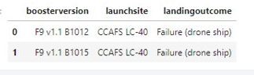
2015 Launch Records
Code
%sql SELECT LANDING__OUTCOME, BOOSTER_VERSION, LAUNCH_SITE FROM SPACEXTBL WHERE Landing__Outcome = 'Failure (drone ship)' AND YEAR(DATE) = 2015;
Outcome

Slide 33
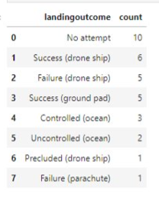
Rank Landing Outcomes Between 2010-06-04 and 2017-03-20
Code
%%sql
SELECT LANDINGOUTCOME, COUNT(LANDINGOUTCOME)
FROM SPACEXTBL
WHERE DATE BETWEEN '2010-06-04' AND '2017-03-20'
GROUP BY LANDING__OUTCOME
ORDER BY TOTAL_NUMBER DESC
Outcome ---->

Slide 34

Section 3

Slide 35
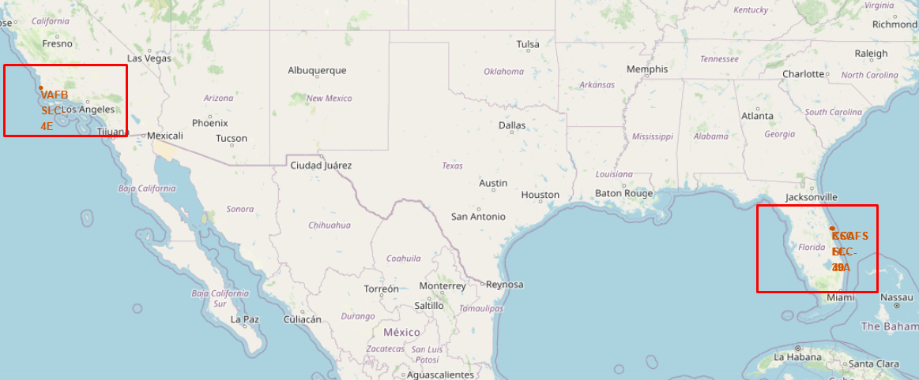
Launch Site Marked on the USA map
The Launch Sites are located in USA and specifically the coast lines near California and Florida

Slide 36
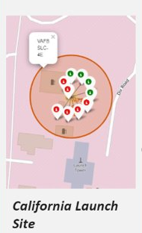
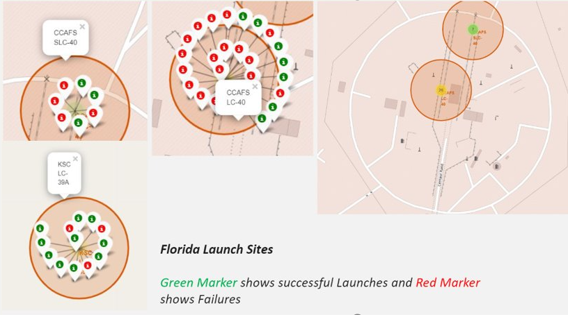
Successful Lauches per Launch Location

Slide 37
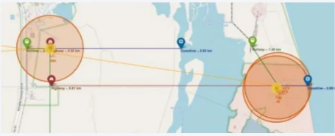
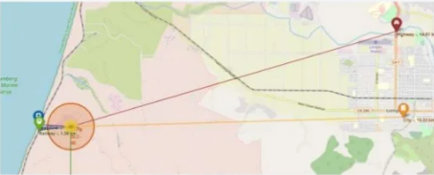
Launch Site distance to landmarks

Slide 38

Section 4

Slide 39

Success Rate per Launch Site – Pie Chart

Slide 40
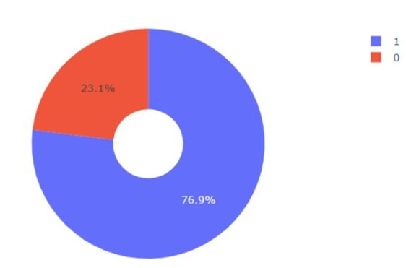
Launch Site with the highest success rate – Pie Chart
KSC LC-39A has the highest Success ratio of 76.9%

Slide 41
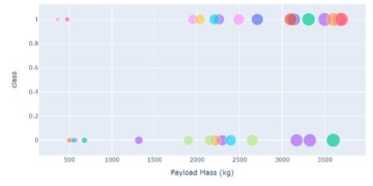
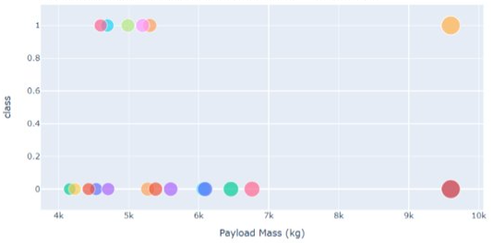
Payload to Success Rate Scatter plot
In the upper the chart refers to a Payload up to 4tons whereas the second one to a Payload beyond 4tons, but less than 10tons. The illustrations show that higher Payloads result in less successful launches

Slide 42

Section 5

Slide 43
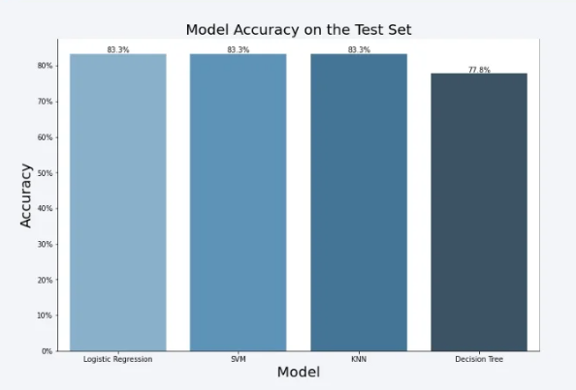
Classification Accuracy

Slide 44

Confusion Matrix
The Matrix refers to the Decision Tree classifier
The model is not a good measurement for the 'False Negatives' since there were twelve cases where the model predicted an incorrect value

Slide 45
Conclusions
Lower weight payloads are mostly connected to higher Success rates
Machine Learning Classification models SVM, KNN and LR showed a surprisingly identical Evaluation figure
KSC LC had the most successful launches
Between 2013 and 2017 the Success Rate of all sites showed an upward trend
The Launch Sites are particularly close to the coastline

Slide 46


